Slide 1
Introduction to NCBI Cloud Computing for Biologists
Cooper J. Park, PhD
Notes:
Welcome to today’s workshop “Intro to NCBI Cloud Computing for Biologists”, I’m your host/presenter Cooper, and I’m being helped with the technical side of things by Wayne Matten, Rana Morris, etc.

Slide 2
In this workshop you will learn how to:
Navigate the AWS cloud console page and understand how to access and use some popular console-based tools.
Access and mine metadata for information in the NCBI SRA database to select an interesting dataset for further study using the AWS Athena service.
Retrieve SRA sequence data and perform a sequence alignment analysis using the NCBI tool MagicBLAST.
Visualize the aligned data against the wealth of information in NCBI databases by uploading it to the NCBI Genome Data Viewer browser application.
Notes:
I want to start today by just reminding you all why you’re here: This workshop is designed to give you all a very basic, but hopefully targeted, introduction into the world of Cloud Computing. We know everyone here is coming from a biology background, so we have tried to build this workshop to show you exactly how you can use cloud technologies to modernize/improve/update your research efforts. Additionally, we will show you some examples of how we here at NCBI are making our services and data more available in the cloud so you can get the information you need quicker and easier.

Slide 3
Outline
About NCBI
What is the Cloud
Objective 0 - Logging In
Today’s Case Study
Objective 1 – Navigating the AWS cloud console
Objective 2 – Mining NCBI’s SRA data
Objective 3 – Using magicBLAST & Genome Data Viewer in the Cloud
Wrap up & Billing
Notes:
The outline for today is pretty straightforward: We’ll start off with this introduction that I’m giving you now and cover some basics about what NCBI is/does, what the CLOUD is/does, and then jump into our hands-on exercises. Don’t worry, we’ll also have a few breaks scattered throughout! At the end, we’ll tie everything together and also talk about how you can pay me for the workshop today... Just kidding! Billing means we’ll go over the most popular question in cloud computing “How much does it cost”.

Slide 4

What is NCBI?
We are a center within the NLM responsible for creation, curation and maintenance of medical and scientific databases and other things…
We receive, create, archive & make available biomedical information,
as well as perform computational biology & IT systems research…..
but we really aspire to help make sense of the information!

Slide 5

What is “The Cloud”
Notes:
So, the first thing we should probably address before we dive into some exercises is what exactly “the cloud” is. For a long time I viewed the concept of “The Cloud” as this almost magical entity that only really advanced technical people could use. I think everyone has an understanding that the Internet is involved, but they don’t really know what it means to “use” the cloud. So, let’s talk about what the cloud actually is.

Slide 6
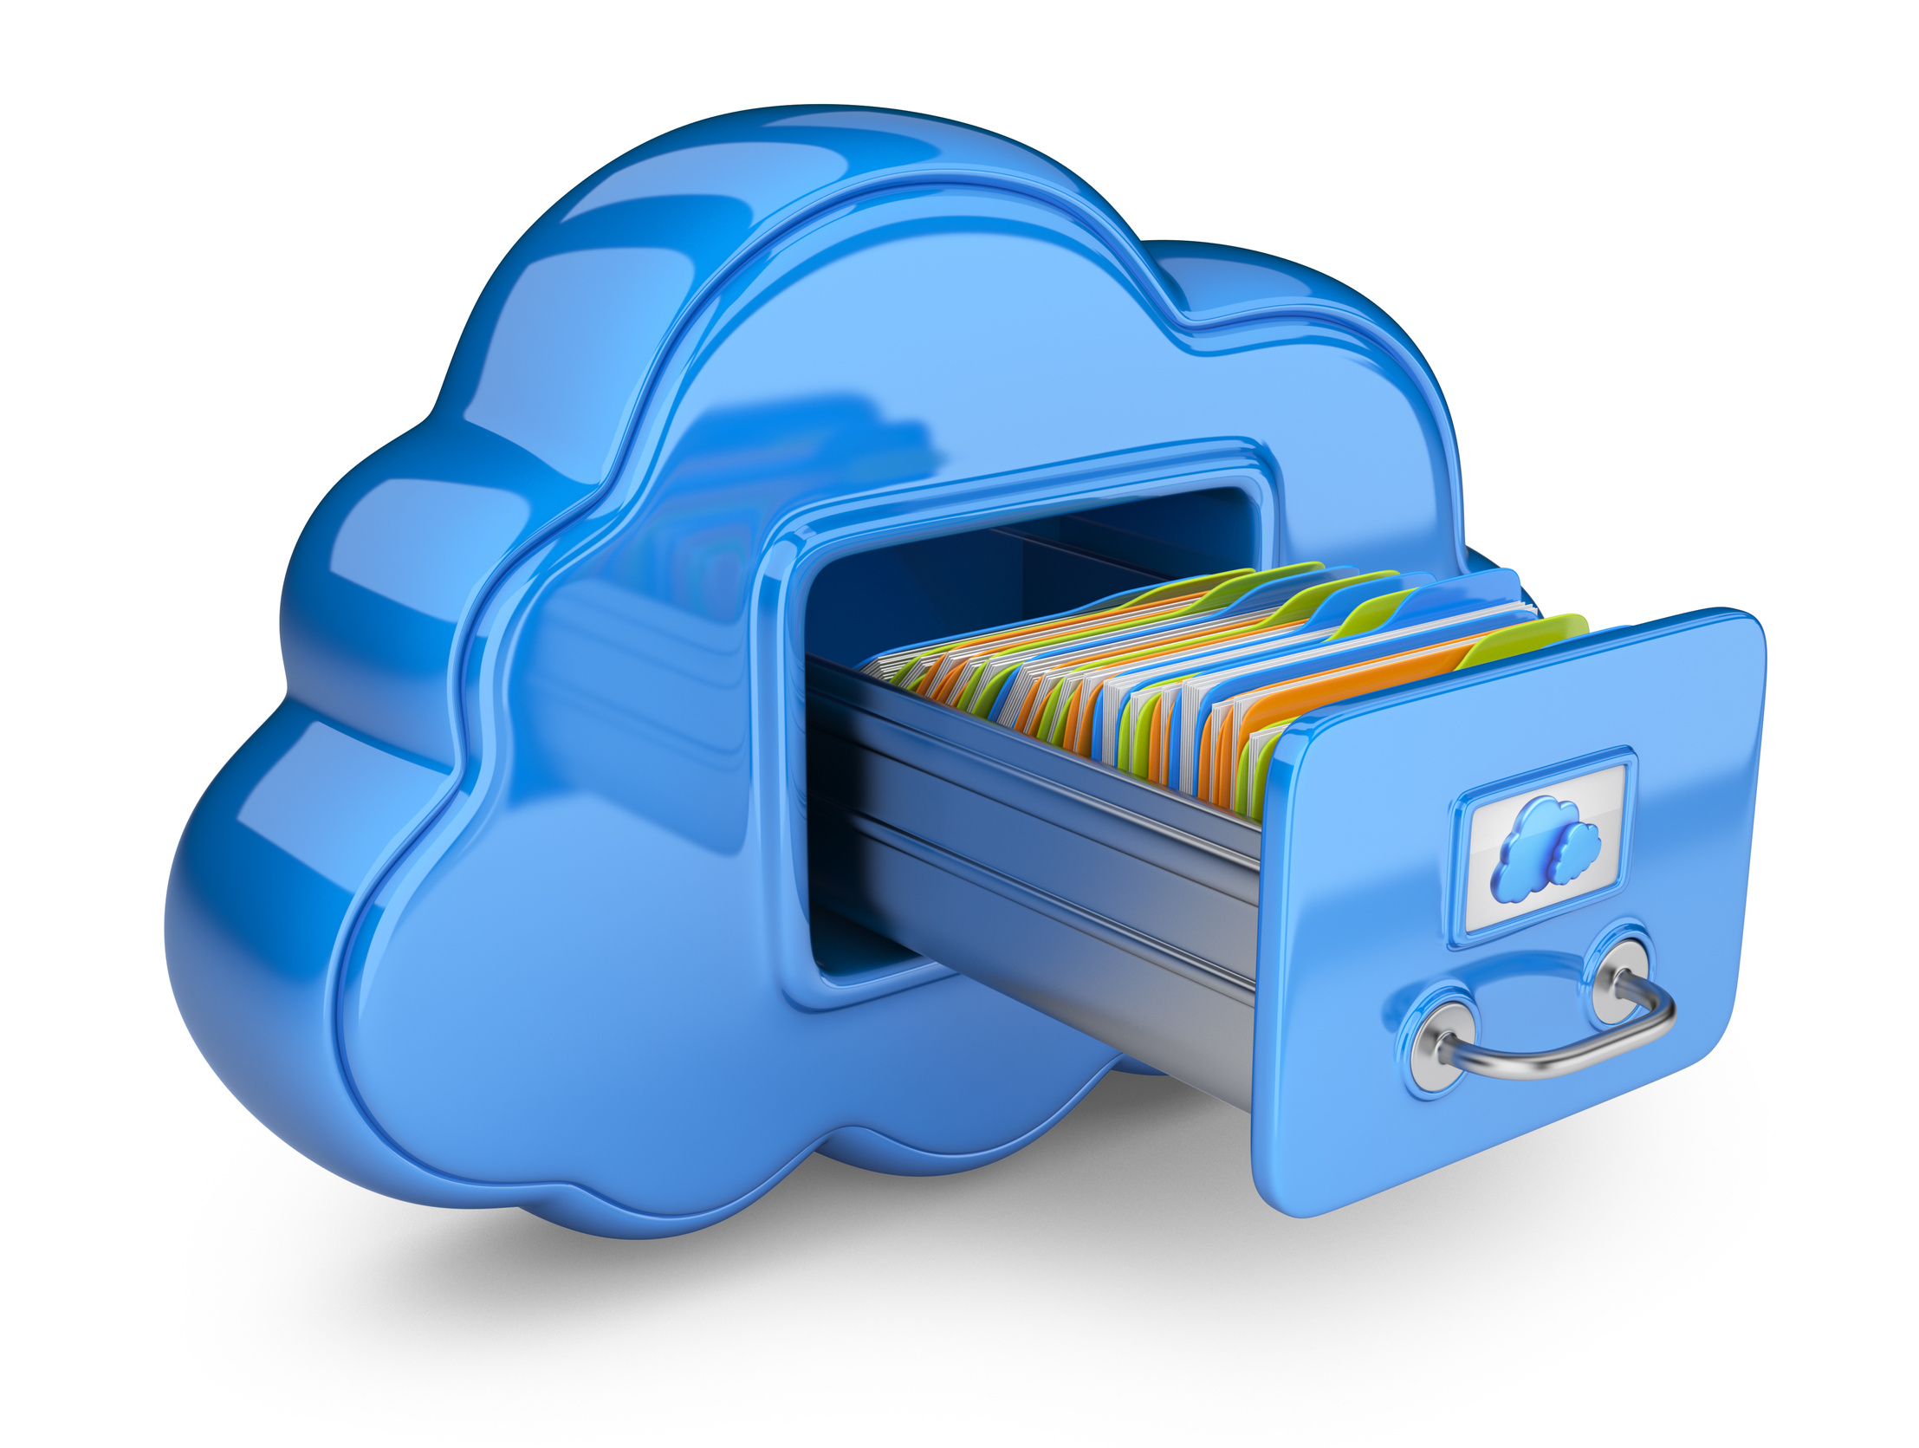

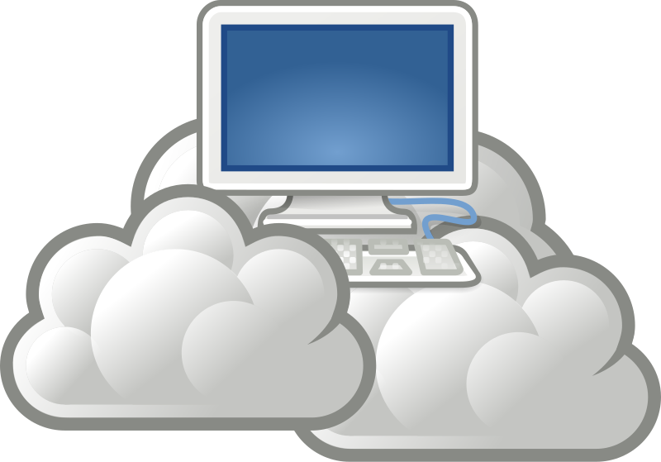
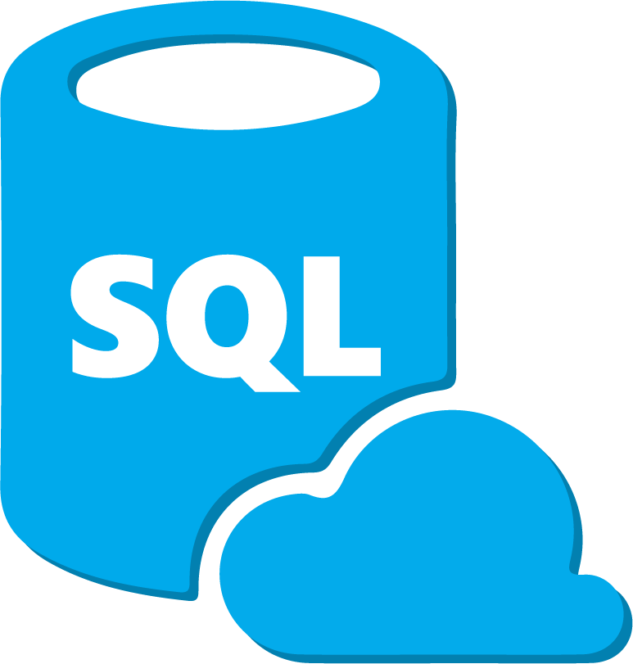
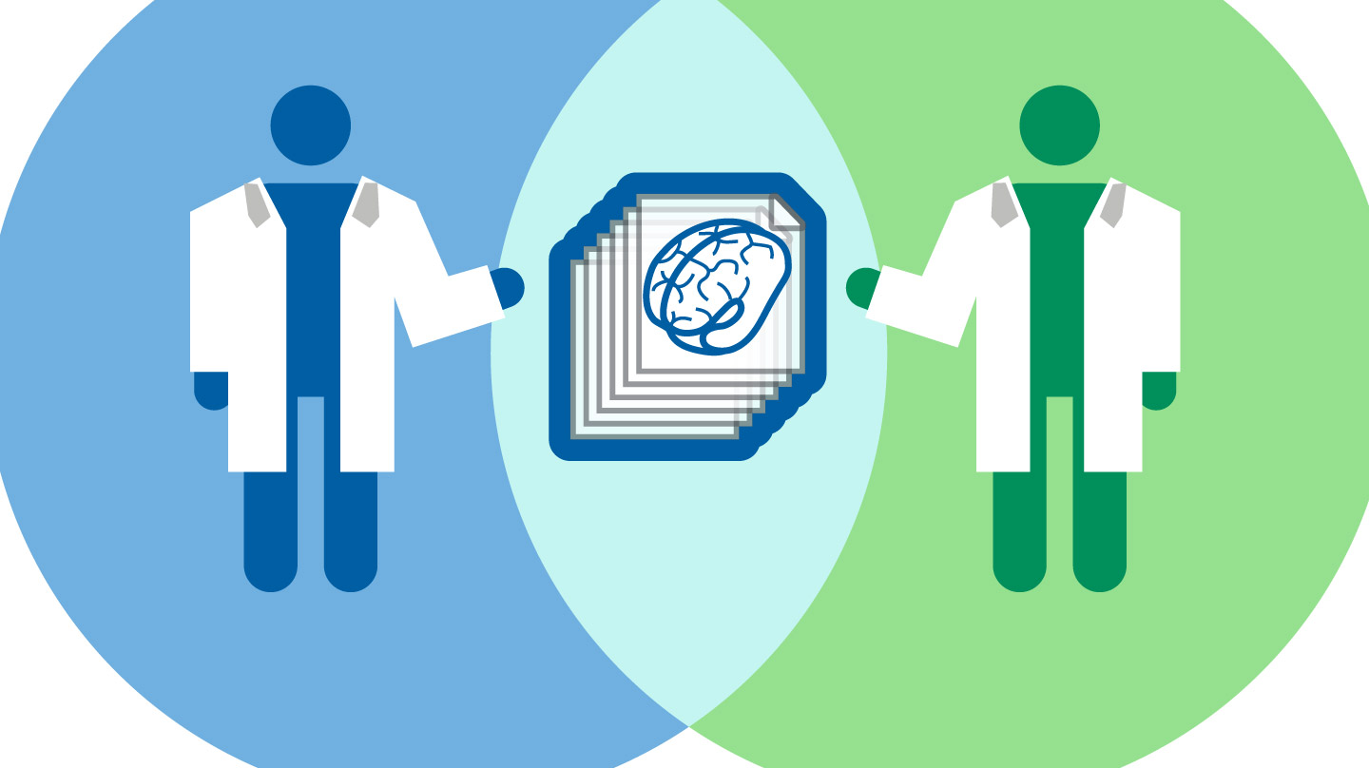
A “one-stop shop” for high-demand computing services delivered across the internet
“The Cloud”
Compute Power
File Storage
AND MORE!
Database Management
Data Sharing
Notes:
The Cloud is basically an all-encompassing term for a “one-stop shop” of different computing services and technologies that a company will offer over the internet to help people manage and process their data. We’ve probably all had a scenario where we are trying to run a program, or open a file, and that little fan in our laptop starts going crazy and the screen freezes up and we think “Gah, I wish I had a better computer!”. Well, the cloud offers us the ability to just “rent” a better computer to do the work we need. For example, you can literally buy more processing (or compute) power so you can manage those laptop-freezing sized files very rapidly. Of course, when you’re done, you can also store that data in the cloud. You’ll also see later in this workshop how we can manage that data in a database to make retrieving or filtering that data very convenient. And perhaps one of the most important aspects of the cloud is the ability to easily share that data with other researchers or members of your own team. And of course, there are so many more services that can be offered that describing them would be a workshop by itself!

Slide 7
POLL!
Which aspect of your own computational research slows your progress down

Slide 8
Reasons to use the cloud
Cost Pay only for what you use Often cheaper than managing your own infrastructure | 2) Global Access - Data can be shared and accessed seamlessly on a global scale
3) Speed and Performance Resources can be optimized for specific needs Workflows can be scaled to meet demand New technologies/services constantly developed and immediately available | 4) Reproducibility, Security, and Reliability Easily back-up, protect, version control and recover crucial data Computing environments can be saved with 3rd party tools to replicate workflows
Notes:
Now, while there may be a lot of services to utilize, without knowing what they all actually do you may not be very motivated to explore the cloud (well, everyone here may think differently since I doubt you would be here if you weren’t interested in the Cloud at least a little bit!). But still, there are a lot of good reasons why you may consider the cloud.
First, the cost. Most folks actually find this to be the most intimidating factor of trying out cloud computing, but it’s actually very affordable. For example, one of the biggest advantages is that you only have to pay for the resources you use. There is no “subscription fee” or down-payment necessary to get into the cloud. Simply find the resource you want to use, jump in, and you can get a bill later on for only exactly what you took advantage of. Additionally, because these services are offered to a global audience, the companies that offer these services can bring them at very competitive rates that rival, or often times beat, you trying to invest in your own computer infrastructure. Not to mention the effort you save by not having to deal with your own infrastructure!
Next, is the accessibility of cloud resources. Any data you generate or store in the cloud can easily be shared with people across the globe. This is great for research collaborators, or even groups like us here at NCBI who want to make sure people can get access to the data they need as soon and as easily as possible.
Reason #3, you can get your work done faster. Every cloud service I have used offers MANY customization options to optimize the service to fit your needs, including even managing the cost of the service. But, if you find yourself with an influx of data, or a new project that needs extra resources, it’s a very easy task to scale your cloud service up to meet those demands. Plus, these cloud provider companies are constantly developing new tools and software that may end up helping you even more.
And lastly, the cloud is extremely reproducible and reliable. Data storage services offer back-ups, version control, and more to keep your data secure. Additionally, the actual workflows you develop for your research can be easily packaged together and shared with colleagues to keep your work reproducible.

Slide 9
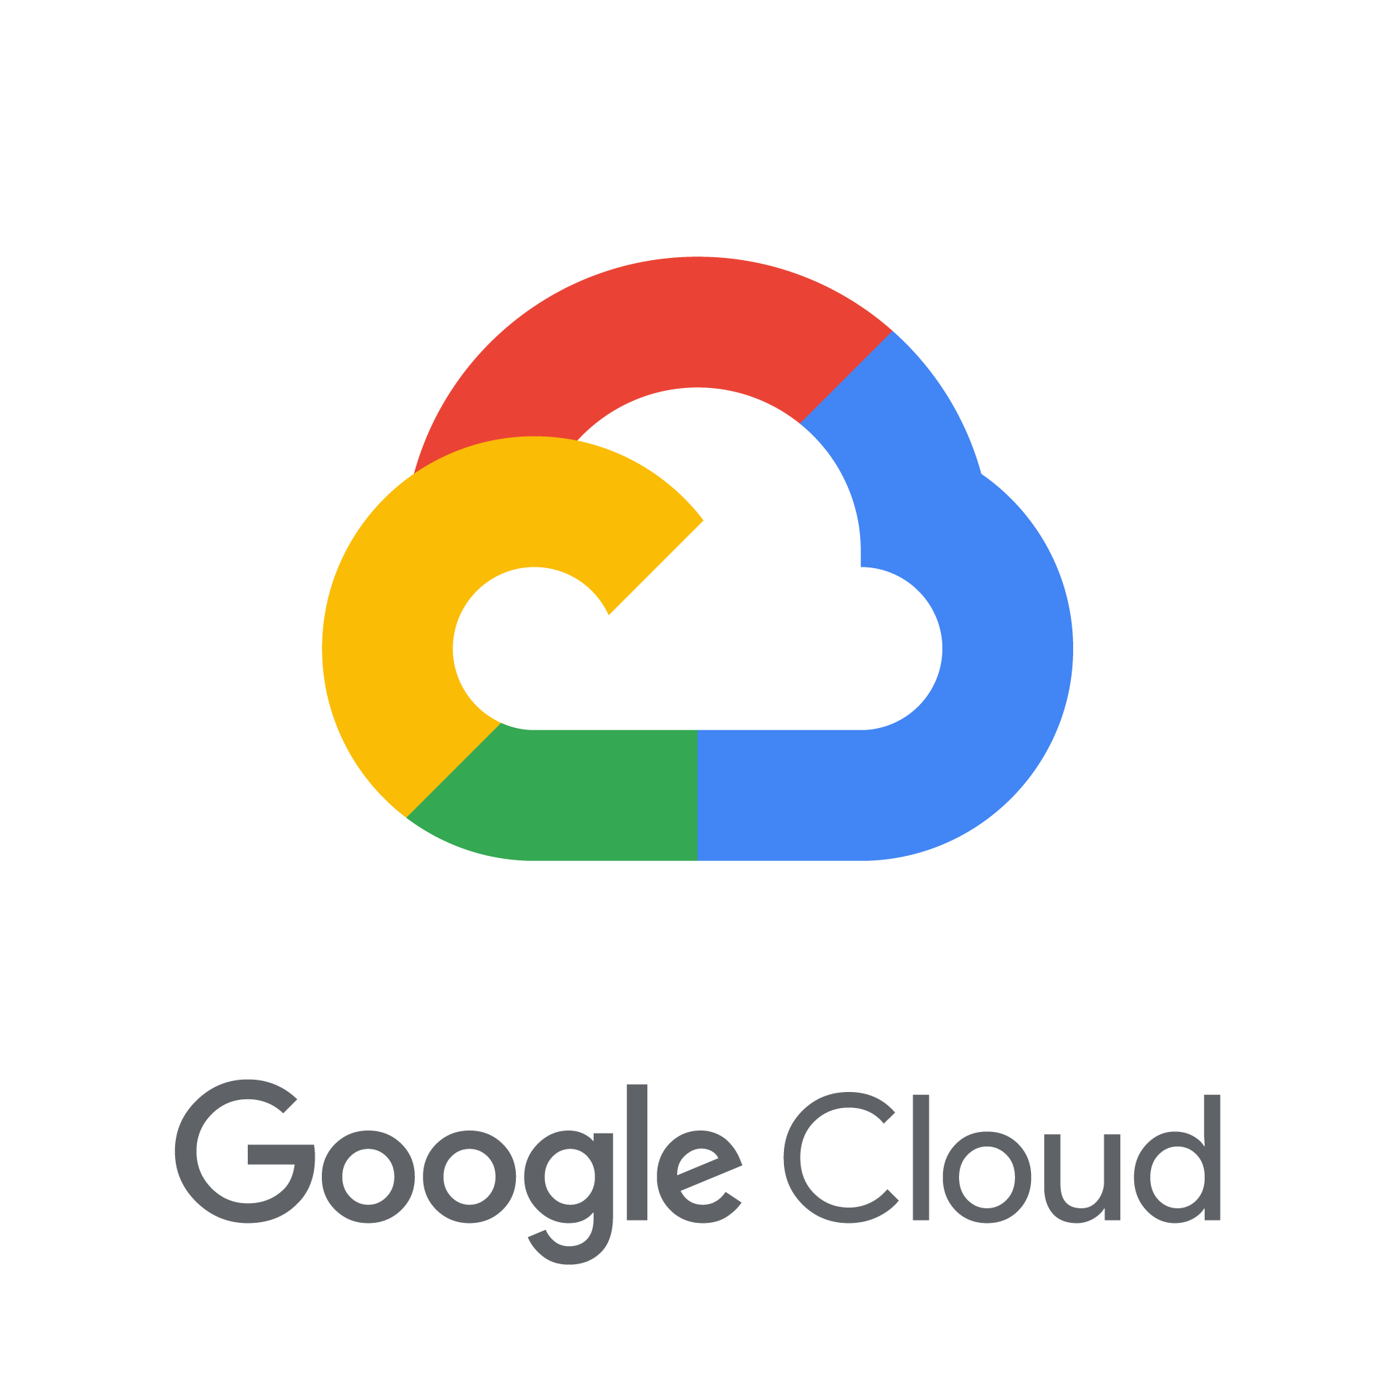
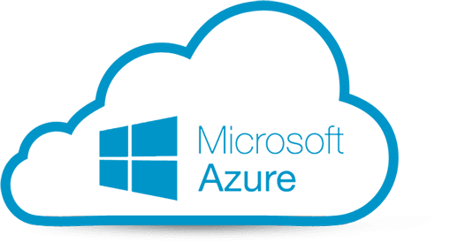
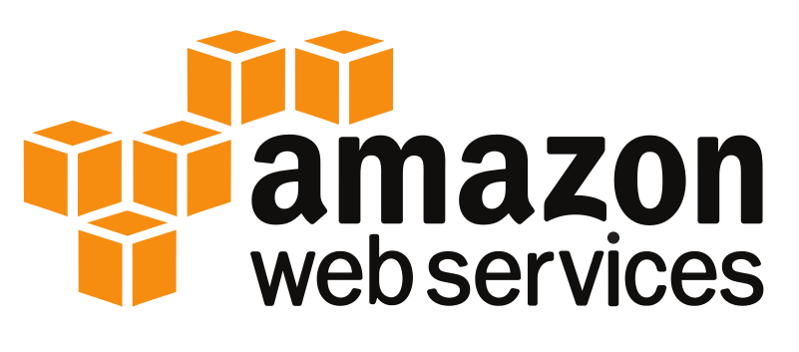
Meet your commercial cloud providers
Notes:
So when you decide to get into cloud computing, chances are high that you will at least start with one of these 3 commercial Cloud providers, Google Cloud (GCP), Microsoft Azure, and Amazon Web Services (AWS).
As an institution, NCBI has a partnership with both AWS and GCP for current and future data collaborations. For this workshop, we’ll be using the Amazon, or AWS, platform to do our cloud exercises. So let’s go over what NCBI and AWS have worked on so far.

Slide 10
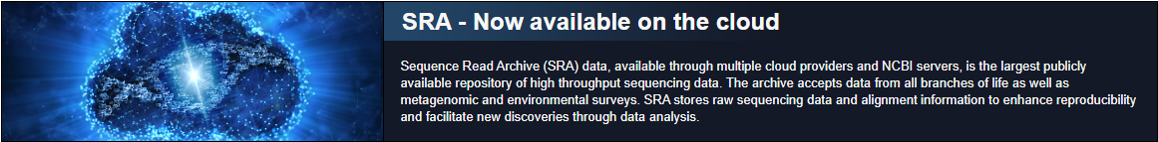
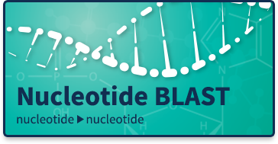
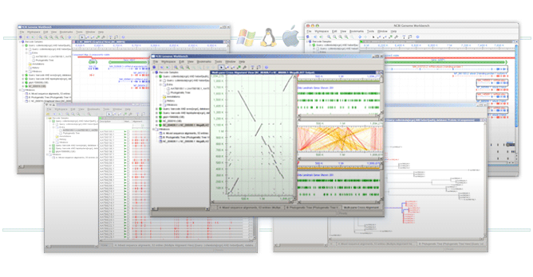
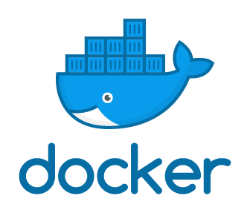
NCBI and the Cloud
Genome Workbench
Notes:
Perhaps the biggest contribution NCBI has made to world of cloud computing is making the SRA database publicly available on the AWS and GCP cloud platforms. Specifically on AWS, all 10 Petabytes of data are available for free access from the AWS Open Data Program. Now to access that data, AWS has their own tools to interact with it, so we’ll get into at least one of those later in the workshop.
Additionally, NCBI has created cloud-friendly versions of many of the most popular software packages. BLAST and its many different variants exist as downloadable programs, plus them and many other programs have also been packaged into Docker containers which allows anyone to deploy an reproducible computing environment right to the cloud for consistent and accurate analyses of their data.
Finally, a newer product, the Genome Workbench, provides a visualization option for your data, especially when comparing it to data stored in NCBI.

Slide 11
Objective 0 – Logging in & Navigating the AWS Console page
Notes:
But before we do ANY of that, we need to get everyone logged into their cloud accounts. I’m going to take a minute to create everyone’s accounts using the email address you used to register for the workshop. So let’s take a short 5 minute break to stretch your legs and refill your drink, and then when you’re back we’ll go through the login process.

Slide 12
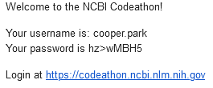
Login Walkthrough
Subject line: NCBI Codeathon Credentials

Slide 13
Outline
About NCBI
What is the Cloud
Objective 0 - Logging In
Today’s Case Study
Objective 1 – Mining SRA metadata using AWS Athena
Objective 2 – Aligning sequence reads using AWS EC2 & MagicBLAST
Objective 3 – Visualize read alignment in Genome Data Viewer
Wrap up & Billing

Slide 14

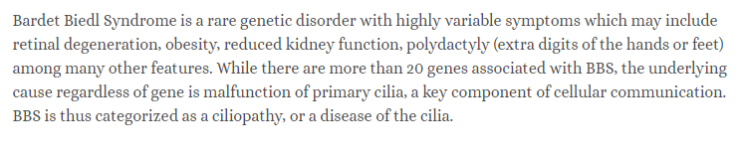
Case Study – Clinical background
Through years of clinical tests and evaluations, a 3-year-old Guyanese child is diagnosed with Bardet-Biedl syndrome (BBS).
Authors sought to confirm this clinical diagnosis using some newer “long-read” sequencing technologies.
Paper - https://www.ncbi.nlm.nih.gov/pmc/articles/PMC5778042/
Notes:
“Bullet” – BUT, a common issue with diagnosing BBS is the highly variable number symptoms that may be present in each individual. Fortunately, because of the ever-decreasing cost associated with DNA sequencing, the researchers in this study sought to try and confirm this clinical diagnosis with some DNA sequencing.
<Bar-day> <beed-el>

Slide 15
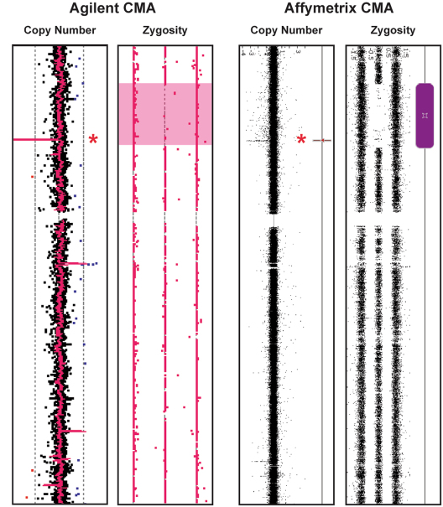
Case Study cont.
Authors first perform a chromosomal microarray test to identify which of the 20 BBS genes could be affected and identify a deletion in BBS9
The BBS phenotype is recessive, therefore Mom & Dad need the deletion too
Paper - https://www.ncbi.nlm.nih.gov/pmc/articles/PMC5778042/
Notes:
The first step for the authors was to find which of the ~20 genes could be mutated. So, they perform a chromosomal microarray test to identify structural changes to the child’s DNA. They identify a large deletion in the BBS9 gene.
Because we know that there are MANY different genes that could be causing this developmental disorder, we need to explore this deletion further to make sure its relevant.
To test this, the authors sequenced the child’s genome where they appear to have a deletion. This is where we come in. We are going to try and confirm whether this deletion is truly present using the author’s sequencing data, and then see if we can identify any previously known clinical association with BBS and this deletion using NCBI’s resources.

Slide 16
Case Study – Our goals
Objective 1 – Search for the child’s sequencing reads from deposited into NCBI’s SRA database
Objective 2 - Align the DNA sequences against a template (aka: Reference) genome sequence for comparison
Objective 3 - Visualize the read alignment to confirm the deletion and investigate any known clinical relevance
Paper - https://www.ncbi.nlm.nih.gov/pmc/articles/PMC5778042/
Notes:
To do this, we are going to break our research into 3 goals.
We’ll go search for the author’s DNA sequence reads they uploaded to NCBI’s SRA
We’ll align those reads to a reference version of the human genome to match the patient’s DNA with the region of the human genome it was sequenced from
We’ll visualize this alignment to see exactly where the reads align with the human genome and look for any structural variations like our suspected deletion

Slide 17
Objective 1 – Search for the sequencing reads deposited into NCBI’s SRA database with AWS Athena
Notes:
Now that we are all logged in, let’s move on to our first task: Searching for the sequencing reads deposited into NCBI’s SRA database.

Slide 18
What is the Sequence Read Archive
https://www.ncbi.nlm.nih.gov/sra
Collection of user-submitted nucleotide sequencing reads, most of which are publicly available to download
Current size = >10 petabytes
You can search the data online using the URL above, or by using AWS Athena
Notes:
To kick off each objective, I’ll go over a little background to help orient us into the exercise. So first off, let’s talk about what the “SRA” actually is since we should be getting data from it in just a moment!
The Sequence Read Archive, or SRA, is a massive repository of user-provided sequencing data from any organism in the tree of life and even metagenomic or environmental survey sequencing (aka – Sequencing data containing DNA from multiple organisms). While almost all of the data submitted here is publicly accessible, a small portion of the data is under restricted access. In this repository, you can find raw sequencing data, and, depending on the quality of the submission, you will also get a decent amount of metadata to help you understand the context of how that data was acquired.
Typically, all this data has been available to search and download from NCBI’s website at the link at the top of the slide, but recently NCBI partnered with AWS to upload all of the 10+ petabytes of sequence data and metadata to the cloud for easier, and often faster, access. To get to this data in AWS, we can use a service called Athena.

Slide 19
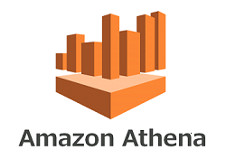
AWS Athena
AWS data-table querying platform designed to rapidly query large tables of data using the SQL language
NCBI offers all SRA read metadata as a table we can import into Athena
We can query the metadata with Athena to pull out only useful sequence data to use in our own research
Results can be saved to an S3 bucket
Notes:
Athena is an extremely powerful table-querying platform designed to rapidly dig through large tables of data using the SQL programming language to filter for data that we are interested in.
As part of NCBI’s and AWS’s partnership, all the metadata associated with every submission in SRA is available as a series of tables that can be imported into Athena. This means we can use Athena to narrow down all of SRA using the metadata to find just the data that we might need for our own research.
Then, once we’ve narrowed down the data just enough, we can save those search results to something called an S3 bucket so we can look back at those results later on.

Slide 20
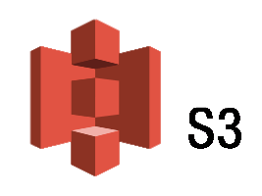
S3 Bucket (aka: “Storage”)
S3 buckets are the “hard drive” of your cloud computer
Designed for long term storage of files and easy sharing
Pay for what you use
Price increases with storage size/duration and data transfer rates
Today’s S3 is free!
Notes:
The second piece of our computer is the “hard drive” where we will store our data and results when we are done using them in the EC2 instance. EC2 instances cost more if you leave them running, so the most cost effective way to regularly access your own files is to place them in an S3 bucket where you can access them anytime/anywhere at SIGNIFICANTLY cheaper costs. In fact, it’s so cheap that to use the S3 bucket today is functionally free for this workshop because of how little time it will be active for, and how little data we will have stored in the buckets.

Slide 21
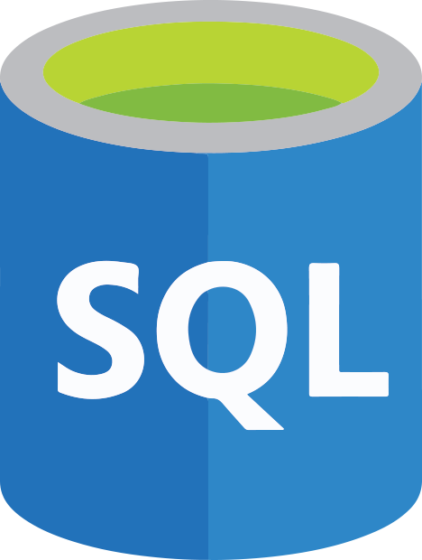
Import results and mine data in table format
Store data mining results and save useful queries
Notes:
Explain what we will build

Slide 22
Objective 1 - Goals
Computational
- Create an S3 bucket to store results and files
Use basic SQL commands to query Athena data tables
Save query results to personal computer and an S3 bucket
Case Study
- Find sequence data associated with case study publication
Find the worksheet at https://go.usa.gov/xH58U
Notes:
Now, before we jump into the exercise, I’d like to preface each one by covering some of the general goals we should strive for by doing the exercise.
So, by the end of this first objective, we should be able to:
Add a table to Athena using AWS Glue, which I will demo in a moment
Create an S3 bucket to save Athena results
Do some basic SQL commands to help filter data in an Athena table
And save those queries to your computer so we can look at the results later on

Slide 23
S3 & Athena Walkthrough

Slide 24
POLL!
How familiar are you with SQL?

Slide 25
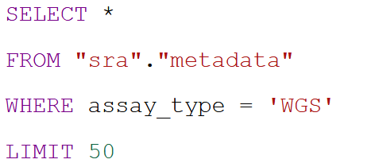
SQL programming language basics
“Give me all of the columns in the table back”
Choose the table columns you want to see for each hit from the table
Choose which table of data you are querying against
Choose the columns you want to filter the data by
Restrict the results to a given number of rows

Slide 26
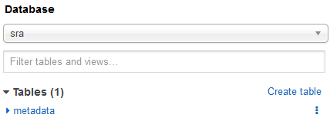
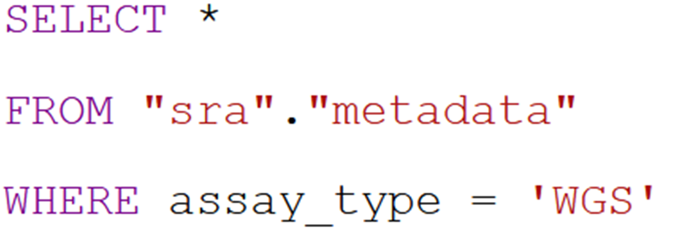
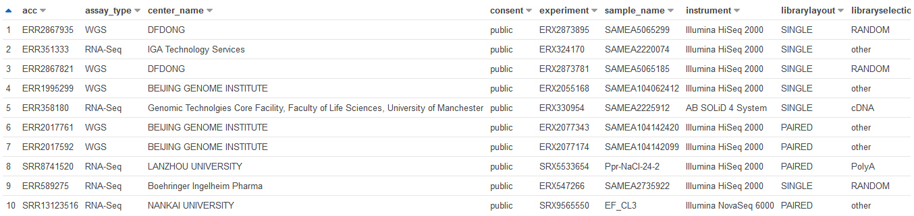

Slide 27
Athena Walkthrough

Slide 28
Objective 2 – Aligning sequence reads using AWS EC2 & MagicBLAST
Notes:
Now that we are all logged in, let’s move on to our first task: Searching for the sequencing reads deposited into NCBI’s SRA database.

Slide 29
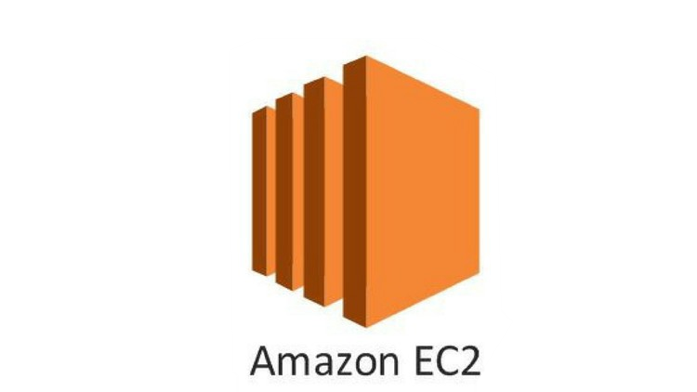
EC2 instance (aka: “Remote Computer”)
EC2 instances basically “remote computers”
Install software, perform data analyses, manage other AWS services using AWS CLI
Lots of different customization options including OS, hard drive space, and memory
Pay for what you use
Price increases with larger hardware needs and longer runtime
Today’s EC2 is roughly $0.20/hour/person
Turn it off when not in use!
Notes:
To do our analyses with our newly found data, will use a service called an EC2 instance. This is basically the equivalent of remotely accessing another computer and letting it do all the heavy data analysis for you. You can install software, run it, and move the your files into other AWS services all with just a basic internet connection.
Lots of customization,
Pay for what you use.
Today, we’ll be installing and using an NCBI program called MagicBLAST

Slide 30
EC2 Walkthrough

Slide 31
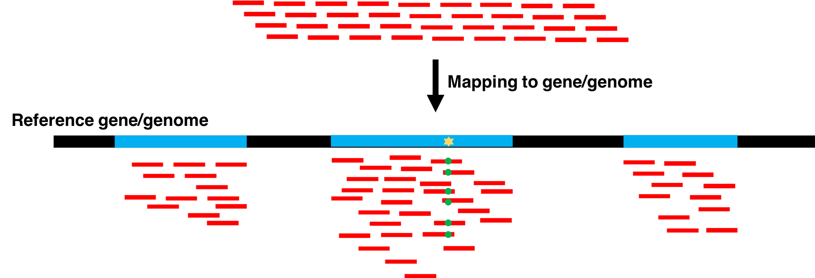
MagicBLAST
A “flavor” of BLAST which aligns next-generation RNA or DNA sequencing reads against BLAST databases
Can use user-created custom databases OR NCBI maintained ones
Documentation - https://ncbi.github.io/magicblast/
Notes:
MagicBLAST is a newer NCBI program designed to align raw sequencing reads against a nucleotide sequence to help identify where those reads came from. This has a lot of value. For example, say you went and sequenced all the DNA you could get in a scoop of dirt... You could use MagicBLAST to align all of those reads to a database of different microbial and fungal genomes to see if any of your reads came from those organisms.
Today, we will use MagicBLAST to help us figure out what part of the human genome our newly found sequencing reads came from.
(Bonus fact for a question – MagicBLAST doesn’t work like other read mapping tools. Instead of indexing the reference sequence, the tool will index batches of sequence reads automatically and compare that to the reference sequence to find matches).

Slide 32
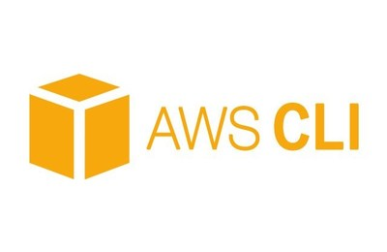
Supporting Software
Samtools
http://www.htslib.org/doc/
Manipulate MagicBLAST files into formats usable by Genome Data Viewer
Amazon Web Service Command Line Interface
https://docs.aws.amazon.com/cli/index.html
Moving data between EC2 and S3

Slide 33
Objective 2 - Goals
Computational:
Create, customize, and manage an EC2 instance
Run MagicBLAST and format output files with Samtools
Upload files from your remote instance to your S3 bucket
Case Study:
- Align child’s DNA to human reference genome for compare against “expected” sequence
Find the worksheet at https://go.usa.gov/xH58U

Slide 34
magicBLAST Walkthrough

Slide 35
Objective 3 – Visualize the read alignment to confirm the deletion and investigate any known clinical relevance

Slide 36
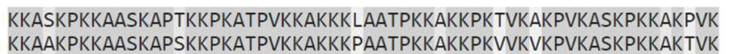

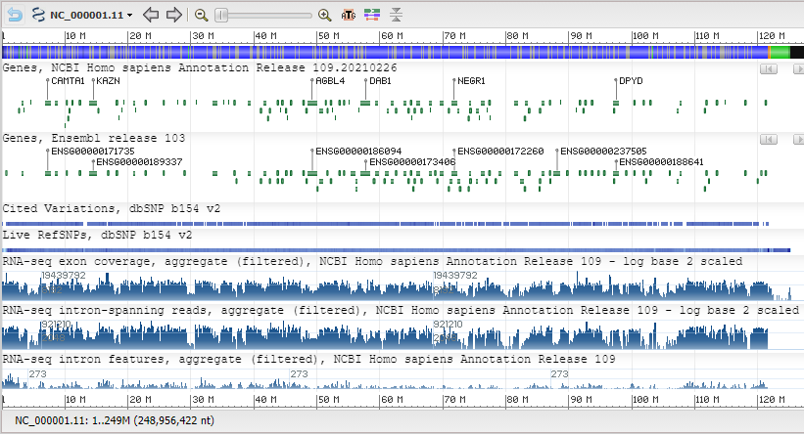
Case Study - Using the sequences
Align Sequences
Reference
Child
Visualize Alignment
Genome Data Viewer

Slide 37
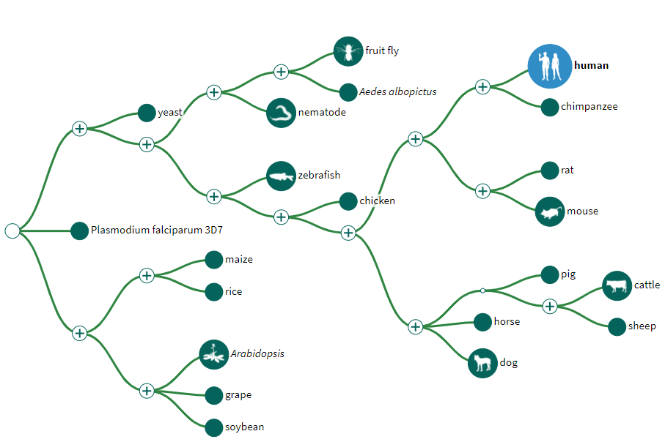
Genome Data Viewer
GDV is a genome “browser” which supports the visualization of genetic data mapped against >1000 NCBI curated/annotated eukaryotic reference genomes
Website - https://www.ncbi.nlm.nih.gov/genome/gdv/
Notes:
“Bullet” – BUT, a common issue with diagnosing BBS is the highly variable number symptoms that may be present in each individual. Fortunately, because of the ever-decreasing cost associated with DNA sequencing, the researchers in this study sought to try and confirm this clinical diagnosis with some DNA sequencing.

Slide 38
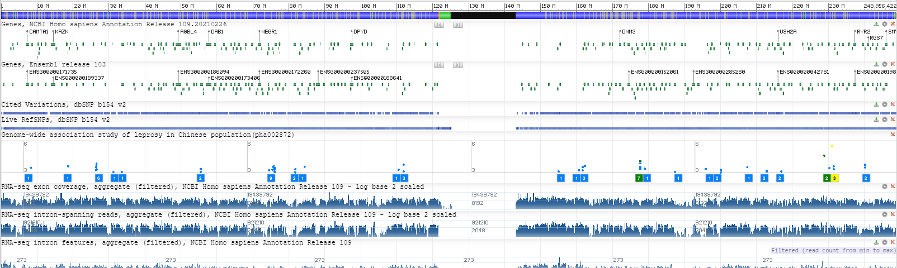
Genome Data Viewer
Data is visualized in “tracks”
Can include gene/feature annotations, sequence coverage, GWAS data, and more!
Users can mix/match between their own tracks and access NCBI/partner provided ones
Website - https://www.ncbi.nlm.nih.gov/genome/gdv/
Notes:
“Bullet” – BUT, a common issue with diagnosing BBS is the highly variable number symptoms that may be present in each individual. Fortunately, because of the ever-decreasing cost associated with DNA sequencing, the researchers in this study sought to try and confirm this clinical diagnosis with some DNA sequencing.

Slide 39
Objective 3 - Goals
Computational:
Access and navigate Genome Data Viewer
Upload custom data tracks to GDV
Parse biological meaning from alignment results
Use NCBI track data to find known clinical relevance
Case Study:
Identify structural changes between patient DNA and reference sequence to identify possible deletions in BBS related gene
Use NCBI dbVar data to match results to known structural variants
Find the worksheet at https://go.usa.gov/xH58U

Slide 40
GDV Walkthrough

Slide 41

Billing
The most important question in cloud computing...
“How Much Will This Cost Me?”
Website - https://www.ncbi.nlm.nih.gov/genome/gdv/

Slide 42
POLL!
How much do you think today’s workshop cost per person?
Notes:
$1 - $5

Slide 43
Billing
The most important question in cloud computing...
“How Much Will This Cost Me?”
Everything you did in this workshop cost ~$0.50
Website - https://www.ncbi.nlm.nih.gov/genome/gdv/

Slide 44
Billing
AWS strives to be transparent about costs
https://calculator.aws/#/estimate - Build a price estimate based on anticipated service usage
https://aws.amazon.com/free/ - View free-tier uses on most AWS services
Several tools such as Cost Explorer can help you break down usage across a group
Website - https://www.ncbi.nlm.nih.gov/genome/gdv/
Notes:
“Bullet” – BUT, a common issue with diagnosing BBS is the highly variable number symptoms that may be present in each individual. Fortunately, because of the ever-decreasing cost associated with DNA sequencing, the researchers in this study sought to try and confirm this clinical diagnosis with some DNA sequencing.

Slide 45
Thank you!
Cooper Park, PhD Wayne Matten, PhD Adelaide Rhodes, PhD Peter Cooper, PhD
Alexa Salsbury, PhD Rana Morris, PhD Dan Rice, PhD

Slide 46
Accessing data tables with AWS Glue
Athena is just a tool to analyze tables. Therefore, we still need a way to import the tables we want into Athena.
AWS Glue creates “crawlers” which automatically parse a data table into Athena.
Benefits include:
Automatically identify file format of table file
Can add multiple tables at once
Automatically update table on regular interval
Notes:
Now to use Athena we need to actually tell it which table we want to explore. One of the most convenient options to do this is to use another tool called AWS Glue. AWS Glue creates a “crawler” which automatically parses a data table into Athena for us to use.

